Slide 1

City of Colorado Springs
2C Advisory Committee Meeting
4th Quarter Report
February 27th, 2020

Slide 2
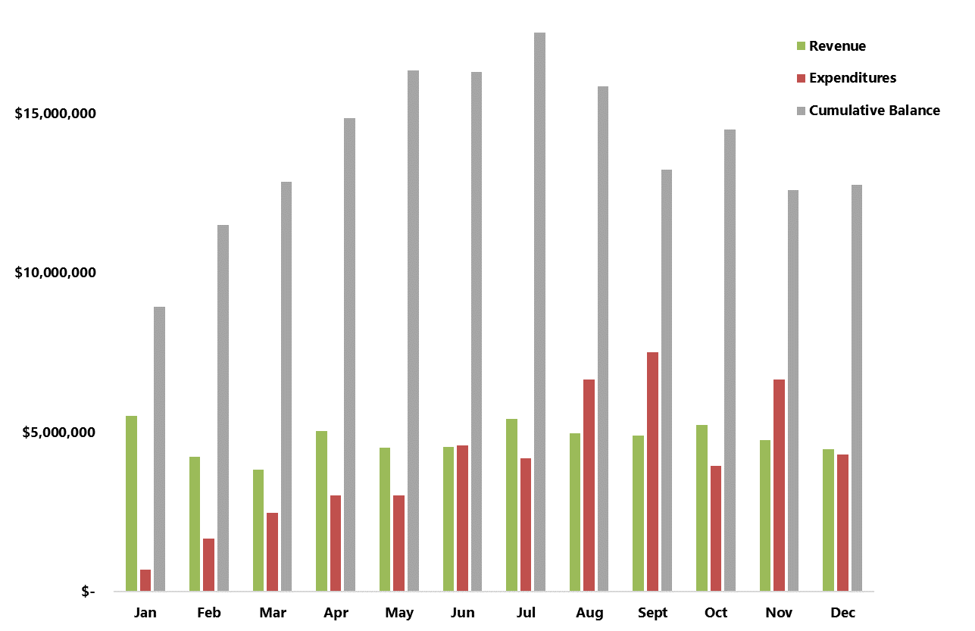
2C Expenditures and Revenue
$12,766,623
Notes:
These are all actuals being reported as reporting for total year is on a month delayed schedule. Revenues for December are known in January.
$9M Beginning Balance – January 2019
$20M max Balance – May 2019
$7M Ending Balance – December 2019
Approximately $63M to start 2020 work and $70M total to complete 2C and begin 2C2 work.

Slide 3
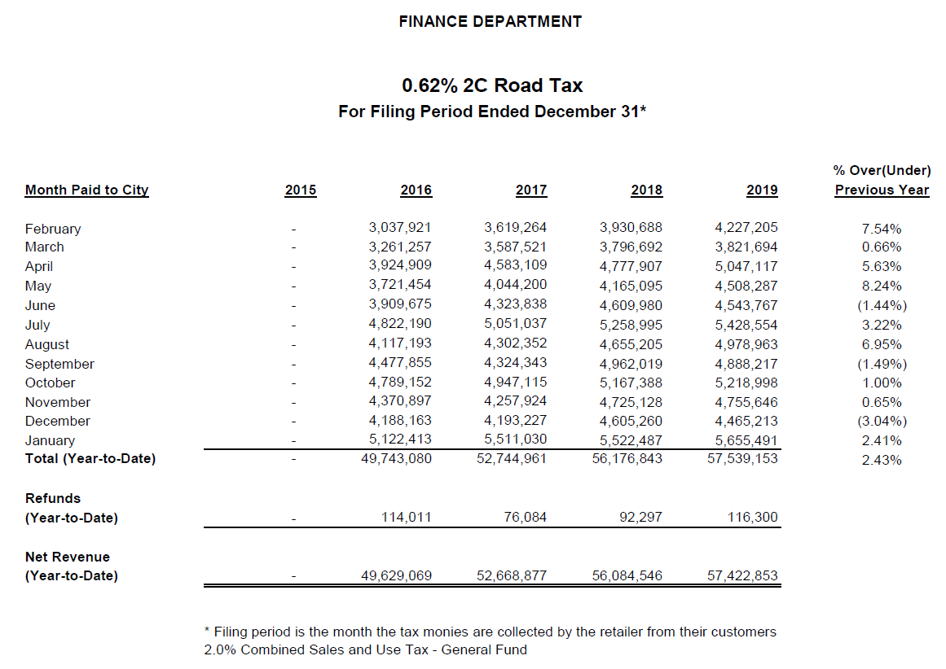
Notes:
Update to include revenues for April
***The Use Tax collections in March of 2018 were skewed abnormally high by a single large collection, so a relatively normal March 2019 Use Tax Collection looks like a large contraction by comparison.***

Slide 4
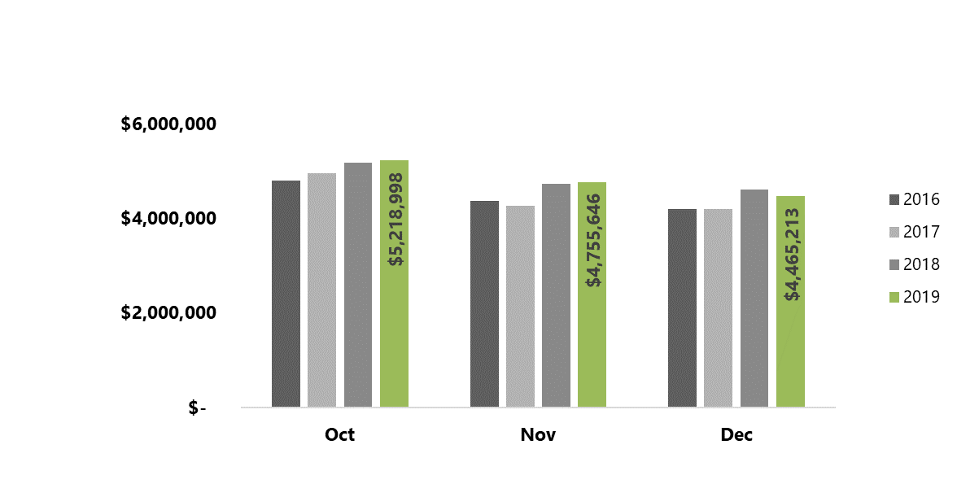
Year-Over-Year Q4 2C Revenue Comparison
Notes:
Revenues are collected the previous month and reported the following month. Hence revenues start reporting in February, and not January.

Slide 5
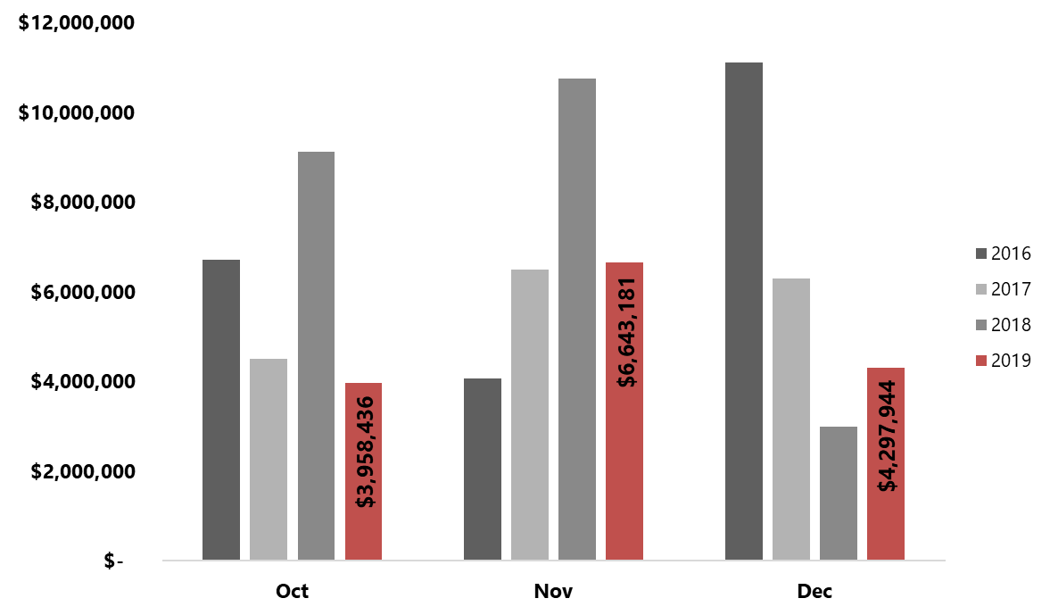
Year-Over-Year Q4 2C Expenditures Comparison
Notes:
YoY expenditures are lower in Q2 as a result of:
Delayed start date preference by contractors
Reduced lane miles in the 2019 overlay list.
Two-week hiatus to assist with other projects (Rockrimmon)
Weather days
I think the change from January being front loaded to back loaded may be partially why if you compare vs Q2, but January is an actual reflection December.
Not seeing this discrepancy vs Q3 report

Slide 6

Budget Report
Notes:
Needs to be linked by Communications

Slide 7
2C Program Spend and Completion Status
Notes:
After some auditing found some incorrect reporting in 2017 and 2018 that adjusted totals slightly in those years, but overall were minor in nature.
May have our first Concrete heavy year due to large 2020 program year and attempt to get ahead in 2019 by more than we ever have.
66/22/18 in Q2 breakout of Program %’s

Slide 8
2C Total Program Update
Notes:
After some auditing found some incorrect reporting in 2017 and 2018 that adjusted totals slightly in those years, but overall were minor in nature.
May have our first Concrete heavy year due to large 2020 program year and attempt to get ahead in 2019 by more than we ever have.
66/22/18 in Q2 breakout of Program %’s

Slide 9
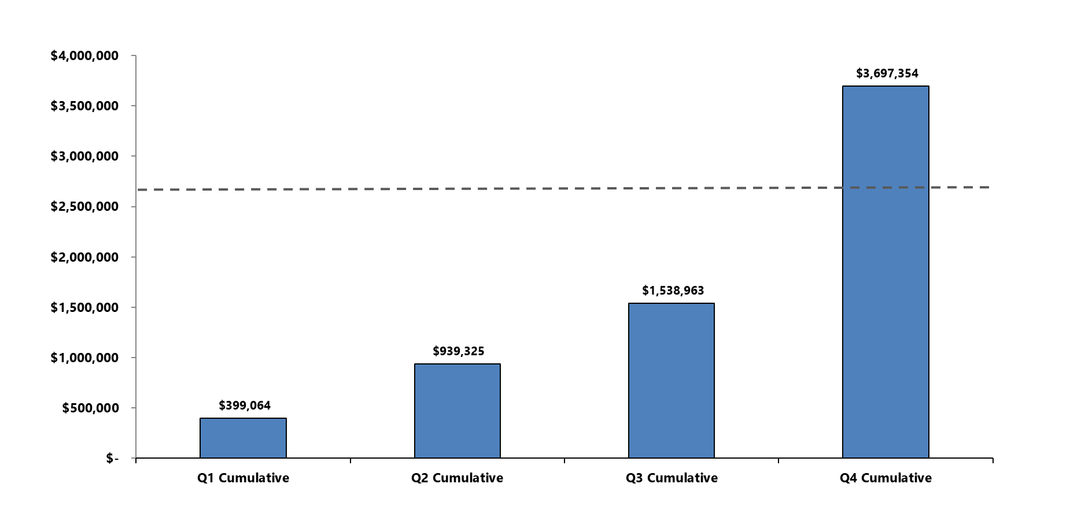
2019 Maintenance of Effort Requirement
*
MOE requirement - $2,698,513
*Provided MOE is an estimate and the City Auditor’s office will post final confirmed number in early 2020
Notes:
Talking Point: As of today we have already exceeded the MOE factoring in CIP spend and anticipated Labor costs
Anticipated MOE - $3.1-$3.3M
Last Year at this time - $1,573,234
34,271 Under last year

Slide 10
Public Outreach
2C Marketing Efforts
    Cone Zone Map
    Waze App
    2C URL
    2C Planned Paving - 5-Year Map
Notes:
Update hyperlink – last bullet point

Slide 11
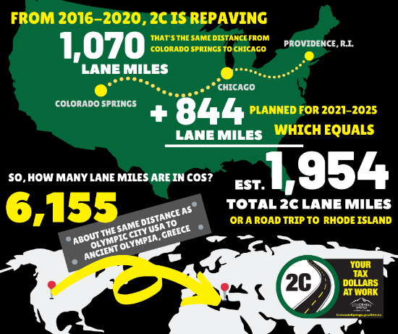
Recent Examples of Public Outreach
Social media posts targeting:
  Progress made to date
  2020 paving list
  Photos of concrete work taking place
  Coordination with Utilities, particularly on Garden of the Gods and North Union
Public engagement for projects with lengthy impacts (Garden of the Gods & North Union)
  Web pages
  Monthly text updates
  Nextdoor posts
  Open House meeting prior to construction

Slide 12











Coordination Efforts
Multiple weekly coordination meetings are taking place with all program stakeholders to include, but not limited to:
  School Districts
  HOA’s
  Businesses
  Hospitals

Slide 13

Coordination
Notes:
Hyperlink with Communications.

Slide 14
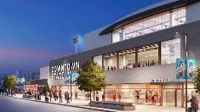

Pre-Overlay Concrete Highlights
Installed Sidewalk Quantified
2.28
1,108
Notes:
Note to Will/ Add YTD totals in Q2

Slide 15
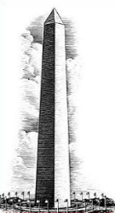
Asphalt Overlay Highlights
Tons of Asphalt Placed Quantified
1.75
Washington Monuments

Slide 16
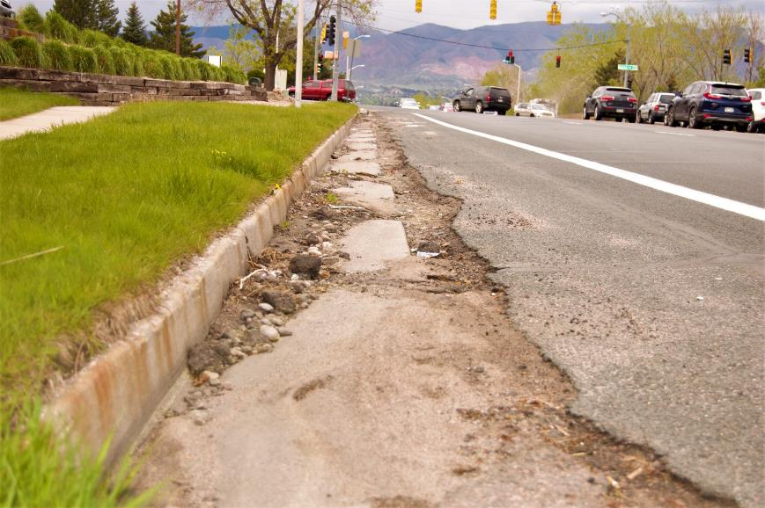
Dublin Blvd
Before maintenance

Slide 17
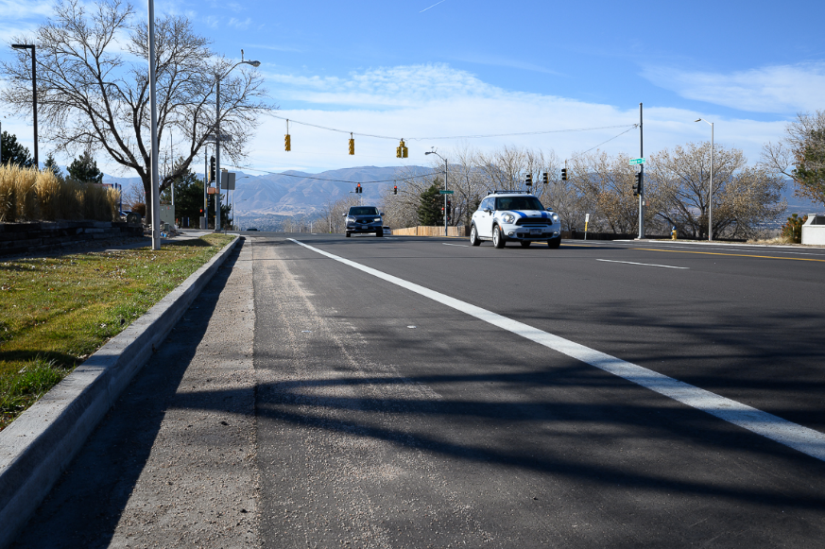
Dublin Blvd
After maintenance

Slide 18
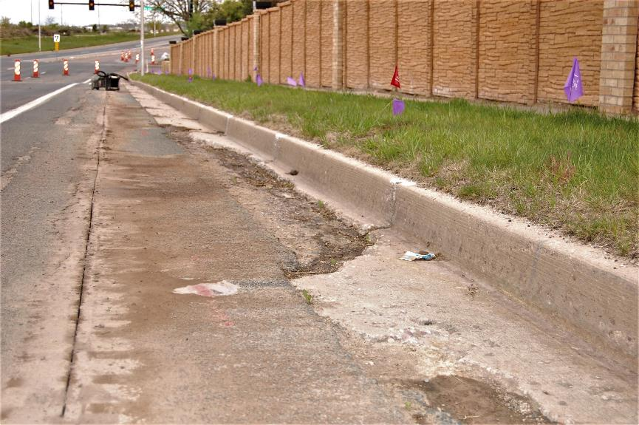
Dublin Blvd
Before maintenance

Slide 19
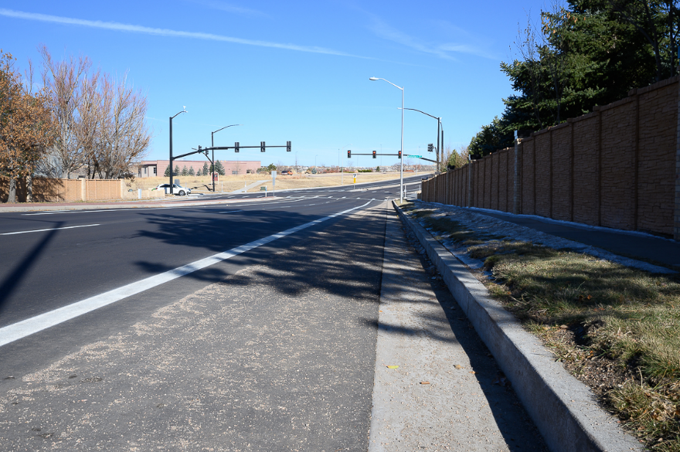
Dublin Blvd
After maintenance

Slide 20
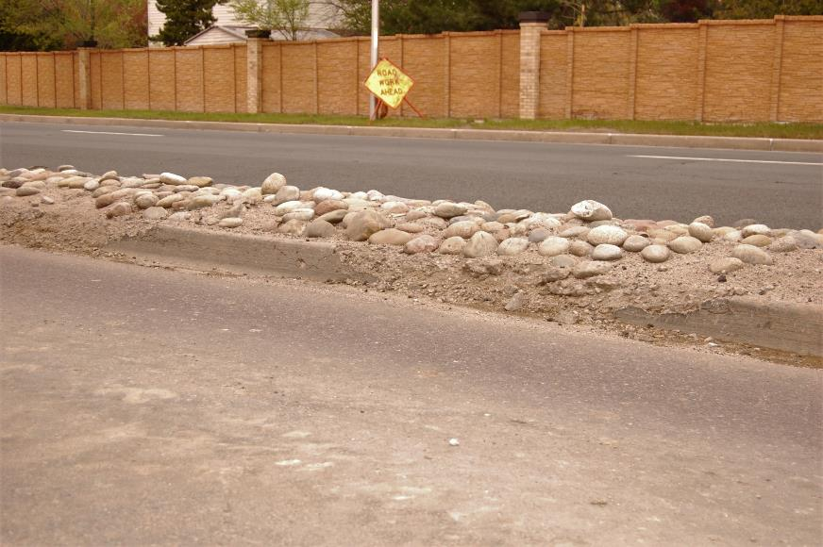
Dublin Blvd
Before maintenance

Slide 21
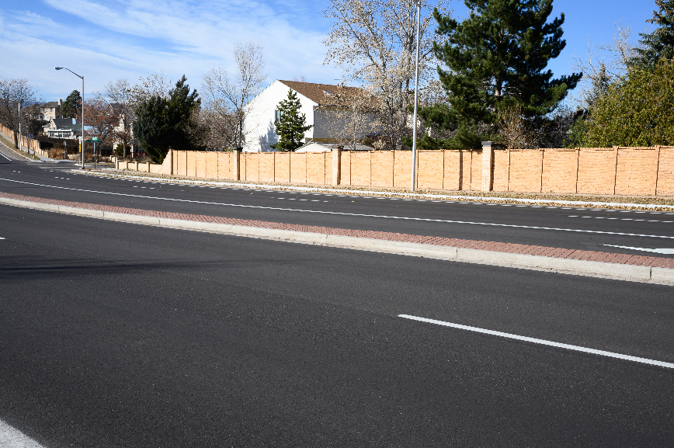
Dublin Blvd
After maintenance

Slide 22
2020 Paving List
Notes:
Emailed Hensley for paving list.

Slide 23
Questions/Discussion
Next Meeting: June 4th, 2020
10:30a - 11:30a
Pikes Peak Conference Room (City Hall)

