Slide 1
Candidate Training for the April 6, 2021 General Municipal Election
January 4, 2021
Sarah B. Johnson, City Clerk

Slide 2
Agenda
Welcome
April 6, 2021 General Municipal Election Introduction
Mayor Suthers - Information on Form of Government
Structure of City Council
President Pro Tem Tom Strand - Councilmember Duties and Presentation

Slide 3
Agenda
Candidate Qualifications and Explanation of Each of the Required Documents
Election Data Requests
Placement of Political Signs
City Campaign Finance Requirements
Time for asking Questions

Slide 4
April 6, 2021 General Municipal Election
General municipal elections are held the first Tuesday in April of odd-numbered years
All municipal elections are non-partisan and nominations are by petition. City Charter Article XI, Section 11-30
The City Clerk is the designated election official for the City of Colorado Springs

Slide 5
April 6, 2021 General Municipal Election
ITEMS ON THE BALLOT
District City Councilmembers race (a four year term)
Possible referred questions

Slide 6
Mayor Suthers - Information on our Form of Government
City of Colorado Springs is a Home Rule municipality
Council-Mayor form of government
Colorado Springs City Charter Article 1-30.
Council-Mayor Government.
The municipal government provided by this Charter shall be known as the "Council-Mayor Government." Pursuant to its provisions and subject only to the limitations imposed by this Charter, all powers of the City shall be vested in an elective Council and Mayor. (1975; 2010)

Slide 7
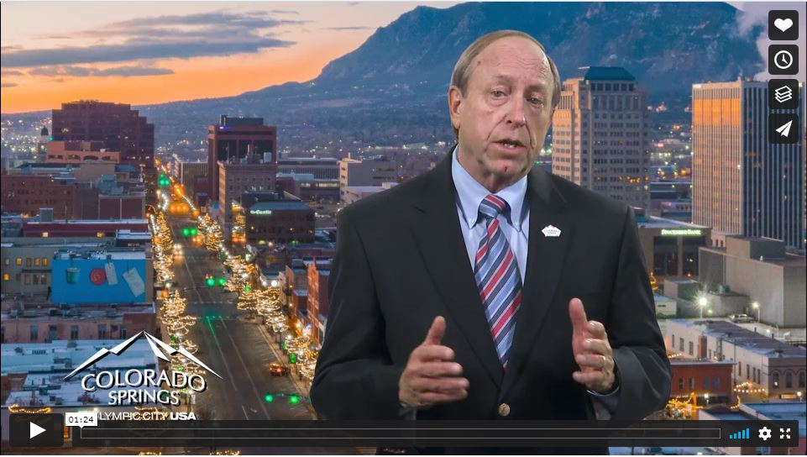
Mayor Suthers - Information on our Form of Government
https://vimeo.com/495877734

Slide 8
Office of City Councilmember Information
There are 9 City Councilmembers.
6 District seats
3 At-Large seats
City Councilmembers receive an annual stipend of $6,250 as established in the City Charter.

Slide 9
Office of City Councilmember Information
City Council Meetings
Regular meetings are on the 2nd and 4th Tuesday of each month at City Hall.
Work Sessions are on the Monday prior to each Regular meeting at City Hall.
Councilmembers also serve as the governing board of Colorado Springs Utilities and they meet the 3rd Wednesday of each month.

Slide 10
Office of City Councilmember Information
City Council Offices are located in City Hall.
City Council has seven support staff members.

Slide 11
Office of City Councilmember Information
CITY CHARTER ARTICLE 3-10.(a)General Powers. All legislative powers of the City shall be vested in the Council, except as otherwise provided by law or this Charter. (1909; 1920; 1977; 1993; 2005; 2010)
(b)Executive or Administrative Functions. Except as otherwise set forth herein, whenever an executive or administrative function or duty shall be required to be performed by ordinance, the same shall be performed by the executive branch and not by the legislative branch. (2010) (c)Duties. To provide for the future of the City, Council shall maintain a strategic plan which prioritizes goals for the City Council and establishes measurable outcomes. The plan process shall consider public input. Council shall provide the plan and goals to the Mayor for consideration in the development of the municipal administrative budget. (1909; 1920; 1977; 1993; 2005; 2010) (d)Accountability. The City Council shall provide for an annual "Report to the Citizens". (2005; 2010) (e)Appointments. The Council shall appoint by the concurring vote of a majority of its members a City Auditor and a City Council Administrator, whose duties, compensation, and tenure of office shall be as prescribed by ordinance. All votes upon appointments to office shall be upon roll call and recorded. The Council shall direct and supervise the City Auditor and the City Council Administrator, and shall delegate to the City Auditor and the City Council Administrator the authority to direct and supervise employees and assistants serving the City Auditor and the City Council Administrator. (1920; 1977; 2007; 2010; 2015) (f)Personnel Policies. The Council shall review and approve by ordinance personnel policies and procedures for all City employees, including civil service employees, but specifically excluding employees of City Utilities and the City's health system; and all municipal purchasing and contracting rules and regulations, it being determined that, as a matter of policy, City Council shall undertake those tasks through the legislative process. (2010) (g)Mayor's Proclamation. The Council may review a Mayor's proclamation in times of public danger or emergency, and may terminate such proclamation at any time by a majority vote of the Council. (2010)

Slide 12
President Pro Tem Tom Strand - Responsibilities of a City Councilmember

Slide 13
April 6, 2021 General Municipal Election
The filing period for candidates for District City Councilmembers begins on January 4, 2021 and ending at 5:00 p.m. on January 25, 2021.
Candidates may obtain a candidate filing packet in the City Clerk's Office, 30 South Nevada Avenue, Suite 101 – Monday through Friday, 8:00 a.m. to 5:00 p.m. or request to have a packet mailed to them.

Slide 14
District City Councilmember Candidate Eligibility
Must be a citizen of the United States of America;
Must be 25 years of age or older on the date of election;
Must have resided in the City of Colorado Springs for one-year immediately preceding the election date;
Must be a registered elector of the City of Colorado Springs, Colorado; and

Slide 15
District City Councilmember Candidate Eligibility
Must reside in and maintain a residence in the Council District for the entire four-year term.
To verify the City Council district your residence is located in go to https://coloradosprings.gov/city-clerk/page/city-council-districts
Go to http://www.govotecolorado.com or contact the El Paso County Clerk and Recorder to verify your voter registration.

Slide 16
Candidate Packet
1. Candidate Information to run for District City Council Member
2. Candidate/Committee Contact Information
3. 2021 General Municipal Election Mail Ballot Plan
4. Maps of Colorado Springs City Council Districts
5. Instructions to Circulators of a Petition
6. Four (4) Nomination Petitions for District City Council Member.
7. Withdrawal of Candidacy Document
8. Affidavit of Independent Candidacy for District Council Member
9. Disclosure of Substantial Private Business Interests
10. Applications for Revocable Permit for Small and Large Temporary Signs and Temporary Sign Regulations
11. Campaign Finance Disclosure Requirements Summary and Frequently Asked Questions
12. Campaign Finance Electronic Filing Authorization form
13. Report of Contributions and Expenditures
14. Campaign Finance Electronic Filing User Guide

Slide 17
Nomination Petitions
Candidates for the District City Councilmember must be nominated by petition(s) containing at least 50 verified signatures of registered electors who reside in the Colorado Springs city boundary and within the same Council District as the candidate seeking nomination.
All candidates should acquire more than the minimum number of signatures.

Slide 18
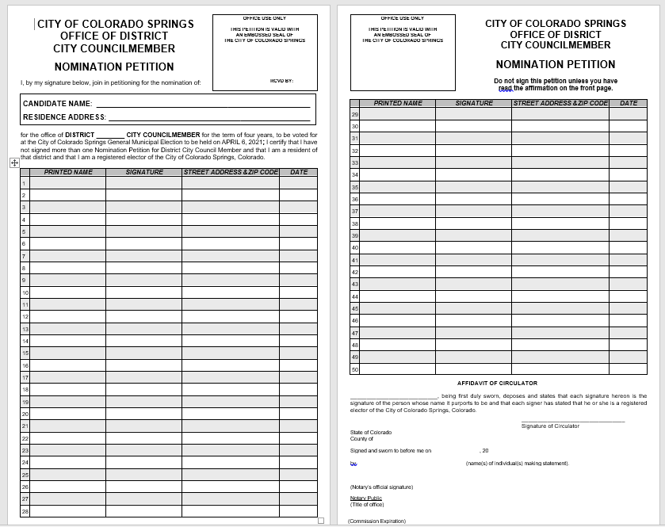
Nomination Petitions

Slide 19
Nomination Petitions
No registered elector may sign more than one Nominating Petition for a District City Councilmember candidate.
Nomination Petitions will be available beginning on January 4, 2021 in the City Clerk’s Office, 30 S. Nevada Ave., Suite 101.

Slide 20
Nomination Petitions
Nomination Petitions may be circulated and signed beginning January 4, 2021 and ending at 5:00 p.m. on January 25, 2021.
The deadline to file Nomination Petitions with at least 50 signatures with the Colorado Springs City Clerk is 5:00 p.m. on
January 25, 2021.

Slide 21
Nomination Petitions
The City Clerk will verify that the Nomination Petition contains the requisite number of valid signatures to be placed on the ballot as a candidate.
If a candidate files a petition that does not have the requisite number of valid signatures, a candidate may have an opportunity to circulate additional petitions to meet the signature requirements prior to 5:00 p.m. on January 29, 2021.

Slide 22
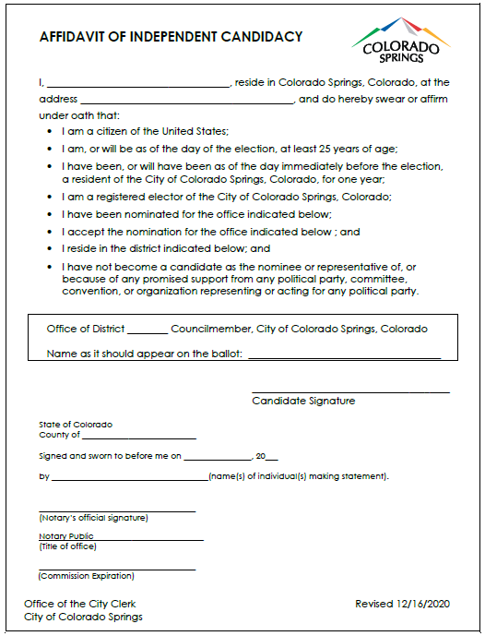
Affidavit of Independent Candidacy

Slide 23
Affidavit of Independent Candidacy
All candidates must file an Affidavit of Independent Candidacy form with the Nomination Petition - City Code 5.2.102.
Within ten (10) days of filing the Nomination Petition and Affidavit of Independent Candidacy, a candidate must file the Disclosure of Substantial Private Business Interests form - City Code 5.2.103.

Slide 24
Candidate Filing Documents
Any candidate who has not
filed a nomination petition with the required number of valid signatures, verified by the City Clerk's Office; and
filed an Affidavit of Independent Candidacy will not be have their name to appear on the April 6, 2021 ballot.

Slide 25
Three Required Documents to Complete the Candidate Filing Process
Candidate Nomination Petition
Affidavit of Independent Candidacy
Disclosure of Substantial Private Business Interests (deadline to file this form is 10 days after you have filed the other two documents)

Slide 26
Completed Candidate Filing Documents
You must file the originals of your completed candidate filing documents with the City Clerk by the required deadlines.
Electronic scans of documents will not be accepted.

Slide 27
Completed Candidate Filing Documents
Ways to return completed documents:
Schedule an appointment by calling (719) 385-5901, Option 4 or email a request to Elections@coloradosprings.gov
Place in the City Clerk Office Drop-Box located in the lobby of the City Administration Building
Mail to City Clerk's Office, 30 South Nevada Avenue, Suite 101, Colorado Springs, Co 80903
Post marked documents are not valid for filing deadlines

Slide 28
Withdrawal from Candidacy/Nomination
A candidate who has met all filing and petition requirements may withdraw from nomination by filing an Affidavit of Withdrawal with the City Clerk’s Office no later than 5:00 p.m., January 29, 2021.
If the candidate is an elected City Officer, additional requirements for withdrawal are found in City Charter 2-10(e).
A candidate who does not file an Affidavit of Withdrawal with the City Clerk’s Office prior to the deadline will remain a valid candidate and their name will still appear on the election ballot.

Slide 29
Election Data Request
Registered Voter List
A list of registered voters can be obtained from the El Paso County Clerk & Recorder.
Details are available at: https://clerkandrecorder.elpasoco.com/elections/voter-lists-maps/
or (719) 575-8683.

Slide 30
Municipal Election Data Request
Prior Election Data
Voter data for the 2017 and the 2019 municipal elections are available for purchase. Data includes eligible voters, returned ballots, and undeliverable ballots.
More information is available at http://coloradosprings.gov/election, (719) 385-5901 option 4, or Elections@coloradosprings.gov

Slide 31
Municipal Election Data Request
Returned Ballot Information
An escrow account must be established with the City Clerk's Office to get an electronic list of voters who have returned their ballot during the election cycle.
Once processing begins, the City Clerk's Office will issue daily reports until the election is complete.
More information is available at http://coloradosprings.gov/election, (719) 385-5901 option 4, or Elections@coloradosprings.gov.

Slide 32
Political Signs and Campaign Materials
For political signs on right-of-ways, a revocable permit from the City Land Use department is required - City Code 3.2.217(D)(1).
Forms are available at http://coloradosprings.gov/election.
Call City Land Use at (719) 385-5905 or visit Suite 105 for more information.

Slide 33
Political Signs and Campaign Materials
For temporary signs on or in front of private property of less than one acre, a maximum of five (5) signs, not to exceed six square feet each, are allowed per street frontage - City Code 7.4.409(E) and 7.4.409(F)(3).
All signs shall comply with City Code 7.4.409(E) and 7.4.409(F)(3).

Slide 34
Political Signs and Campaign Materials
A candidate or committee, or their agent, that publishes a communication in a newspaper, magazine, outdoor advertising facility, any sign requiring a Large Sign Revocable Permit per the Planning Department, direct mailing, handbill, internet-based advertising, or broadcast through radio, television or other technologies, shall disclose in the communication the name of the committee or candidate making the expenditure. The disclosure shall be clear, legible, and conspicuous.

Slide 35
Campaign Finance Reports
The Colorado Springs campaign finance law governs the reporting requirements for campaign donations and expenditures.
Reporting dates and forms are on the City of Colorado Springs website at http://coloradosprings.gov/election.
All filed forms will also be available for viewing at the same web site.

Slide 36
Campaign Finance Reports
The campaign finance cycle for the April 6, 2021 election began on October 1, 2020 and runs through May 6, 2021.
Once a candidate raises or spends $20 or more towards their campaign, they must start filing campaign finance reports.
You may file reports electronically or using paper forms.

Slide 37
2021 Campaign Finance Filing Dates
.
Filing Date | Report starting | Report ending | Filing Date
October 1, 2020 | May 3, 2019 | September 26, 2020 | October 1, 2020
November 2, 2020 | September 27, 2020 | October 28, 2020 | November 2, 2020
December 1, 2020 | October 29,2020 | November 26, 2020 | December 1, 2020
January 4, 2021 | November 27, 2020 | December 30, 2020 | January 4, 2020
January 15, 2021 | December 31, 2020 | January 10, 2021 | January 15 2021
February 1, 2021 | January 11, 2021 | January 27, 2021 | February 1, 2021
February 15, 2021 | January 28, 2021 | February 10, 2021 | February 15, 2021
March 1, 2021 | February 11, 2021 | February 24, 2021 | March 1, 2021
March 15, 2021 | February 25, 2021 | March 10, 2021 | March 15, 2021
April 2, 2021 | March 11, 2021 | March 28, 2021 | April 2, 2021
May 6, 2021 | March 29, 2021 | May 1, 2021 | May 6, 2021

Slide 38
Campaign Finance Reports
Home Rule status means our City requirements may be different than state or other municipal laws pertaining to elections.
City Charter and City Code control.
Records you submit to the City Clerk are subject to public review under the Colorado Open Records Act.
Enforcement: The City Clerk reviews all filings and reviews any complaints filed – using best efforts to do so within 48 hours of submittal.

Slide 39
Campaign Finance Complaint Process
The City Clerk will contact the appropriate person to address the filing or the complaint.
If warranted the City Clerk can issue an order to show cause requiring the person to justify the deficiency and/or requiring the deficiency to be remedied. This order may be appealed.
Civil penalties may apply of $50.00 per day of violation for failure to file required reports, affidavits or other required documents.

Slide 40
City Clerk’s Office Contact Information
Sarah B. Johnson, City Clerk
30 S. Nevada Ave, Suite 101, Colorado Springs, CO 80903
PO Box 1575, Mail Code 110, Colorado Springs, CO 80901-1575
Office Phone (719) 385-5901, Option 4
Mobile Phone (719) 323-9044
Fax (719) 385-5114
Elections@coloradosprings.gov
coloradosprings.gov/election

Slide 41
Any Questions?

