Slide 1
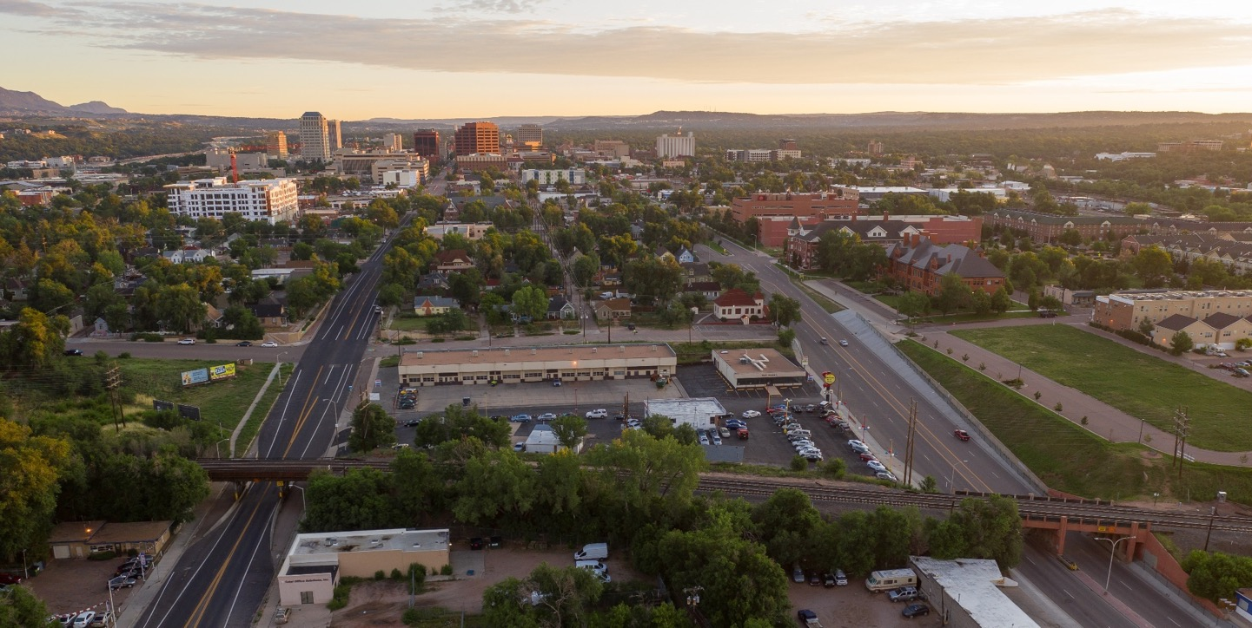
CITY OF COLORADO SPRINGS SOUTH DOWNTOWN RAILROAD UNDERPASS RECONSTRUCTION
September 2020

Slide 2
Purpose
The City of Colorado Springs has initiated a study to determine the best approach for optimal location and design of two railroad bridges at the south end of downtown Colorado Springs. The aging bridges over South Nevada Avenue (70 years old) and S. Tejon Street (115 years old) are in poor condition and require replacement.

Slide 3
Goals
Gain understanding of the long-term needs and opportunities for this public infrastructure
Effectively address railroad operational, maintenance and safety needs
Maintain and improve traffic operations on Nevada Avenue, Tejon Street, and intersecting streets
Complete a Quiet Zone study and implement the findings
Address pedestrian and bicycle connectivity and safety across the railroad tracks
Design bridges and associated improvements that are compatible with and improve access to surrounding neighborhoods and land uses, and are supportive of development opportunities
Design bridges and underpasses to be welcoming and attractive
Address cost effectiveness to construct and maintain the bridges
Develop an improvement program and funding strategy to provide financing through a combination of City, regional, federal, state and railroad sources
Develop beneficial internal and external City partnerships
Inform the public and engage stakeholders potentially impacted by the project

Slide 4
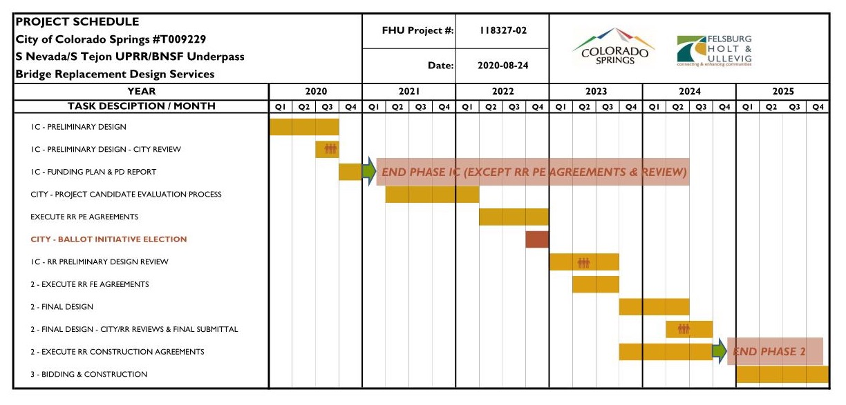
Project Process & Schedule

Slide 5
Project Process & Schedule
2018: Project Initiation and start of stakeholder and public outreach
2019: Planning – Alternatives evaluation and recommendation
2020-2021: Preliminary design and property owner/stakeholder engagement (current effort)
2022: November construction ballot initiative election
2023-2024: Final design and railroad negotiations
2025: Earliest year for start of construction

Slide 6
Alternative H (Reconstruction in existing railroad right-of-way)

Slide 7
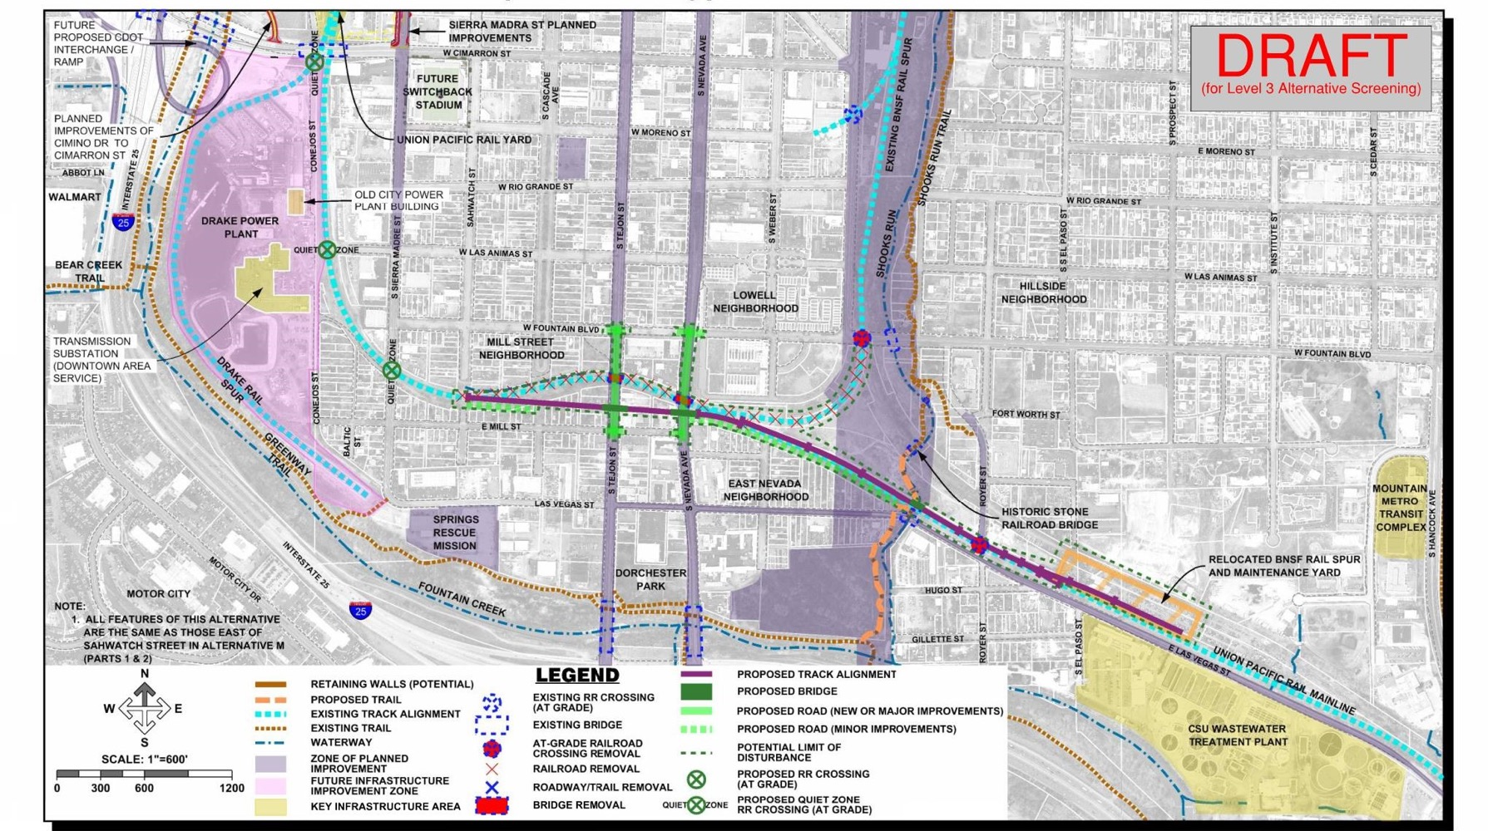
Alternative M1 (now identified as the preferred alternative)

Slide 8
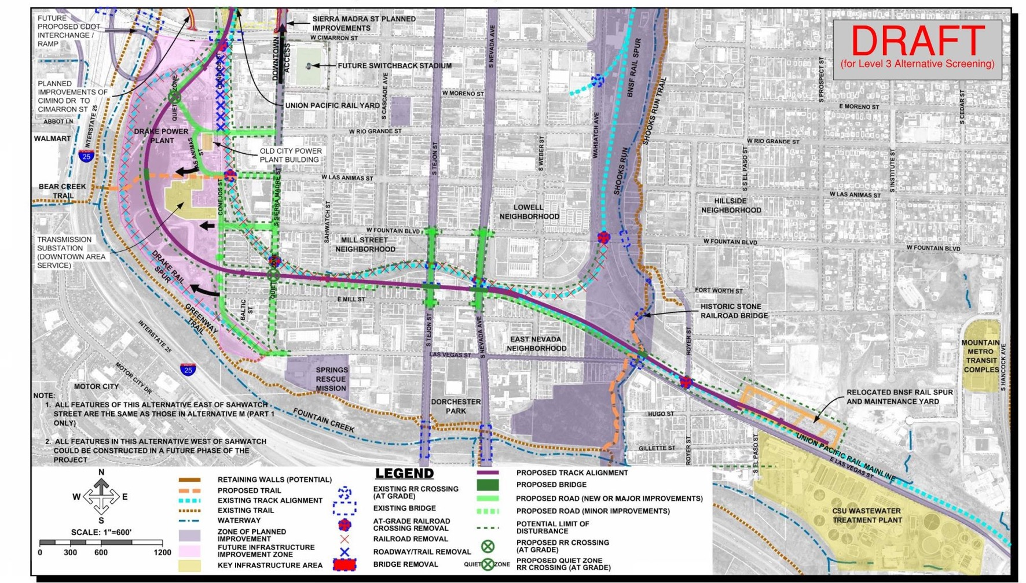
Alternative M (M1 and a potential future M2)

Slide 9
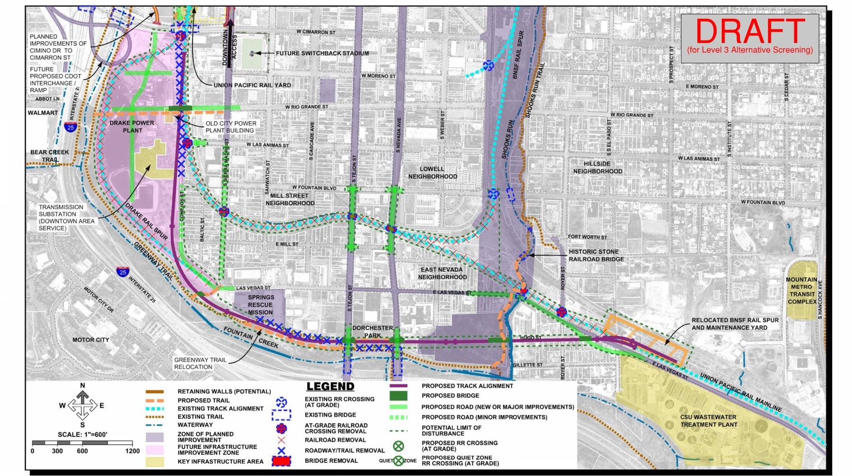
Alternative N (Eliminated)

Slide 10
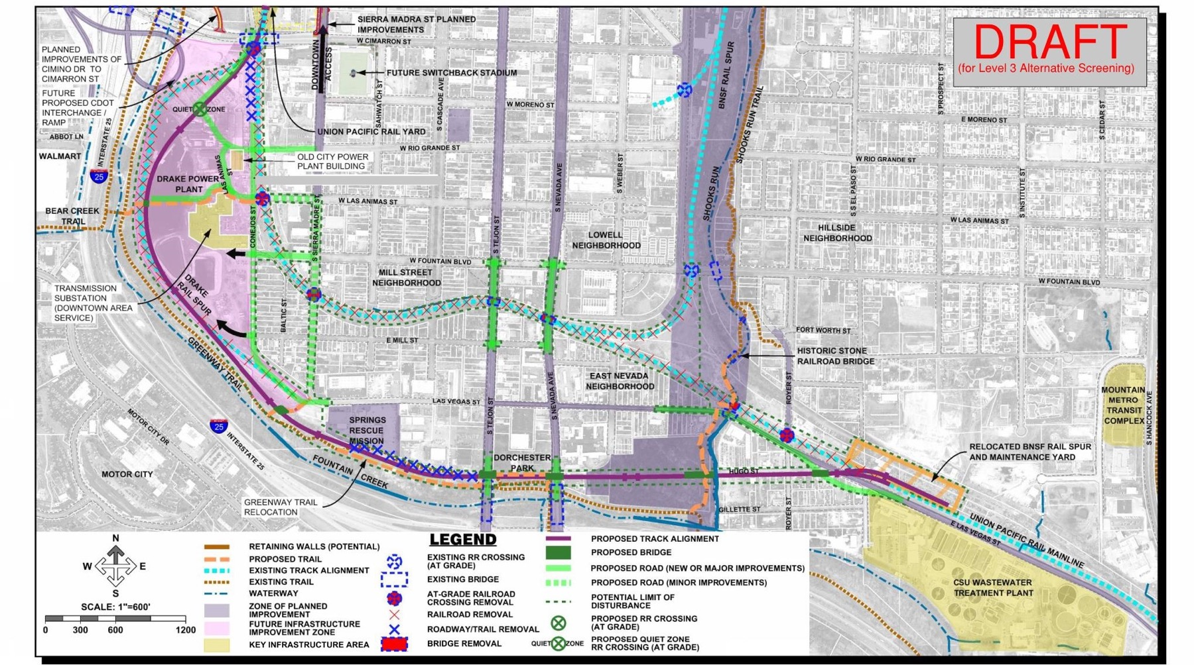
Alternative O (Eliminated)

Slide 11
Cost Estimates Alternative H $53.7 Million Alternative M1 $42.0 Million (Preferred Alternative) Alternative M2 $47.0 Million Alternative N $111.0 Million Alternative O $122.0 Million (These estimates were developed without the Las Vegas/Trail Improvements)

Slide 12
